Slide 1
OpenGL Meshes
Advanced Graphics Programming

Slide 2
VAOs, VBOs, and IBOs

Slide 3
Definition
VBO (Vertex buffer object)
Buffers in the GPU that contain the actual geometry data (positions, normals…)
IBO / EBO (Index / element buffer object)
Buffers in the GPU with indices describing the order in which to render the VBO.
VAO (Vertex attribute object)
Objects in the GPU containing the description (and state) of all attributes in the associated VBO (and possibly IBO).

Slide 4
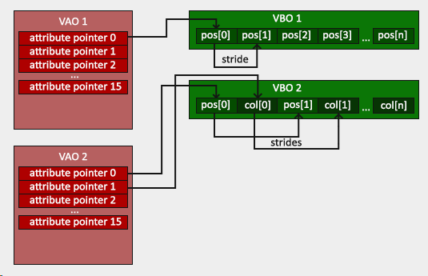
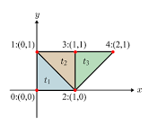
Meshes with vertex replication
VBO data
(0,0)
(1,0)
(0,1)
(0,1)
(1,0)
(1,1)
(1,1)
(1,0)
(2,1)

Slide 5

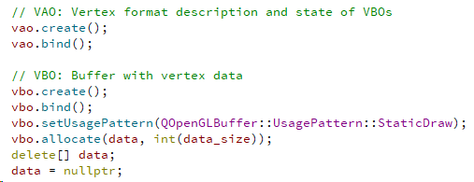
Meshes with vertex replication
Classes in Qt...
Initialization
Render

Slide 6
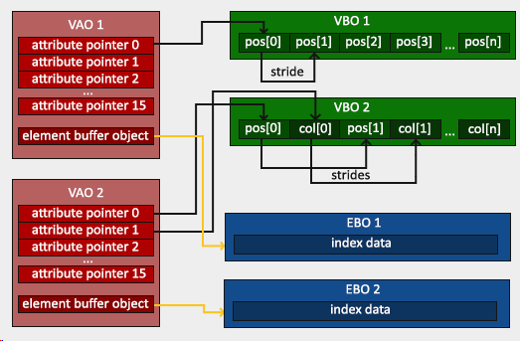
Indexed meshes (avoid vertex replication)
Vertex data
(0,0)
(0,1)
(1,0)
(1,1)
(2,1)
IBO data
0
2
1
1
2
3
3
2
4

Slide 7

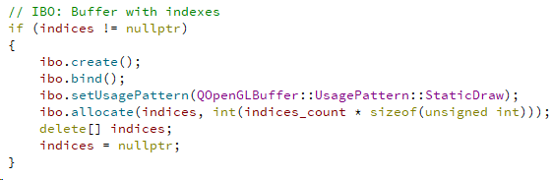
Indexed meshes (avoid vertex replication)
Classes in Qt...
IBO (index buffer object) or EBO (element buffer object) are the same
Initialization (besides vao and vbo)
Render

Slide 8
A (possible) mesh class

Slide 9
UML
Resource
Mesh
*
SubMesh
1
VertexFormat
Container of submeshes.
Object that maps the geometry to the GPU (it contains the vbo, ibo, and vao objects).
Description of the contents of the submesh (which vertex attributes, what are their types, number of components…)

Slide 10
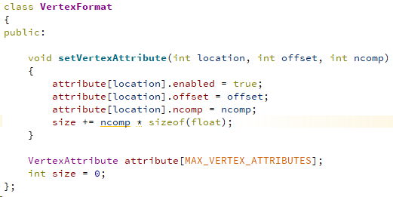
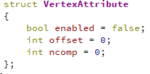
Vertex formats
Mesh
*
Sub
Mesh
1
Vertex
Format

Slide 11
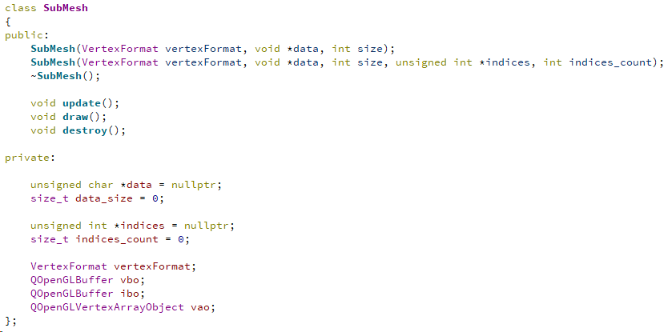
Submeshes
Mesh
*
Sub
Mesh
1
Vertex
Format
An OpenGL context must be active when these methods are called

Slide 12
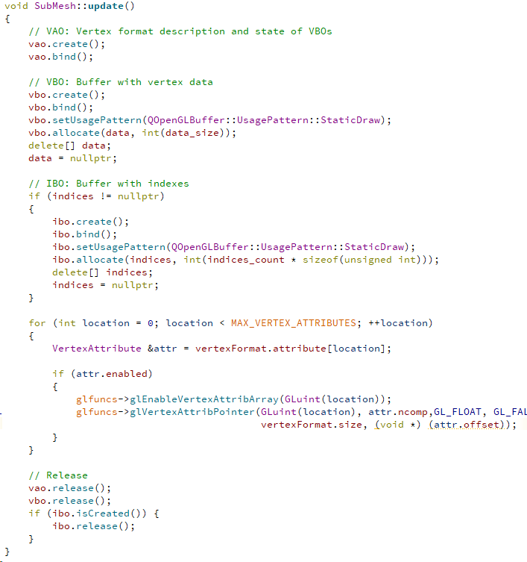
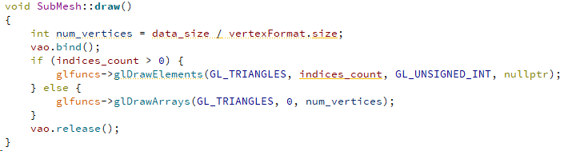
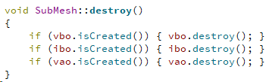
Submeshes
Mesh
*
Sub
Mesh
1
Vertex
Format
Again, these methods need to be called whenever an OpenGL context is active:
update(): the mesh data needs to change
draw(): the mesh needs to be rendered
destroy(): the remove the resource

Slide 13
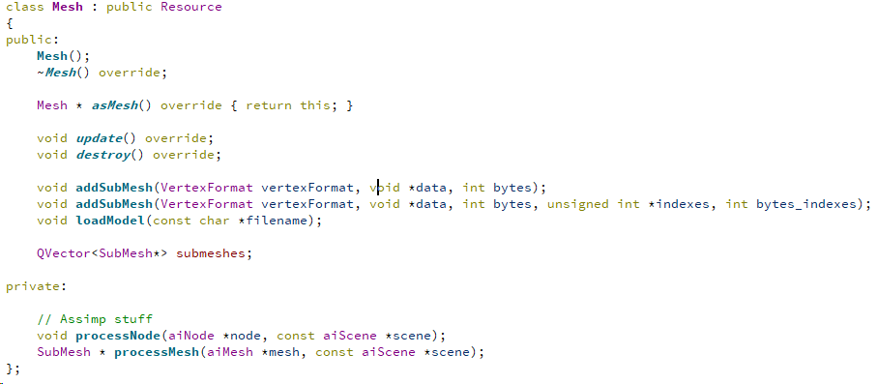
Meshes
Mesh
*
Sub
Mesh
1
Vertex
Format
An OpenGL context must be active when these methods are called

Slide 14
Procedural mesh creation

Slide 15
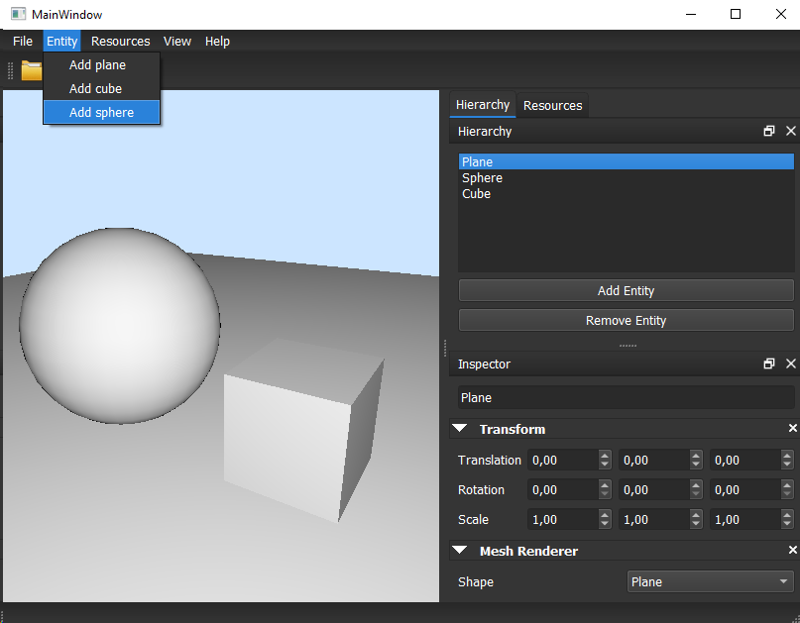
Built-in meshes
All rendering engines have built-in meshes for different purposes:
Prototyping
Debugging placeholders
Rendering purposes
Try to generate some common meshes during the initialization of the application so they can be used later.

Slide 16
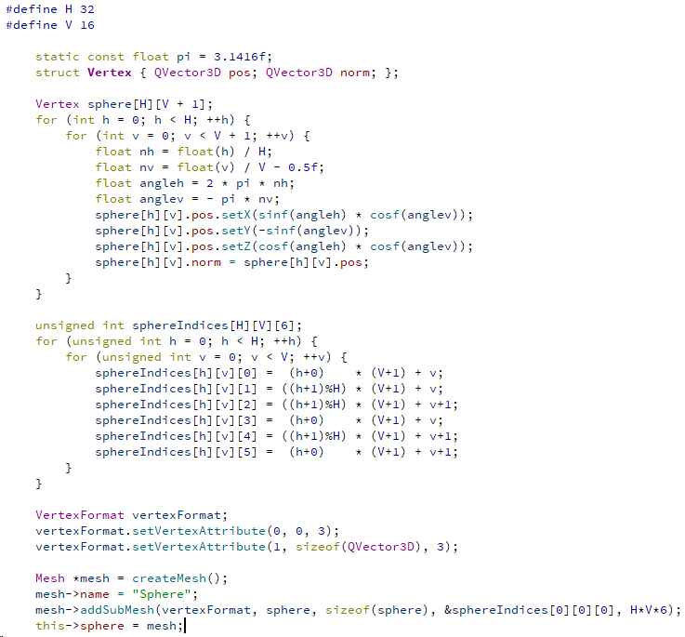
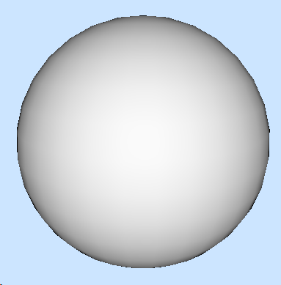
Creation of a sphere mesh

Slide 17
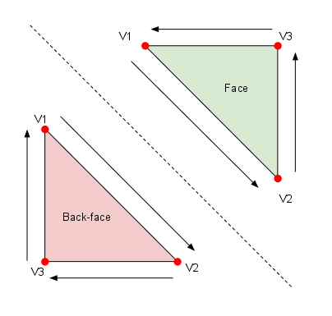
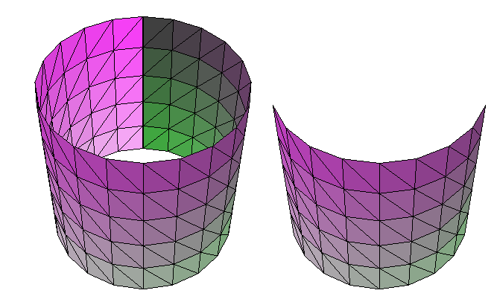
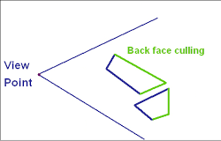
Take into account backface culling
Order or vertices of visible triangles must be counter clockwise
Counter clockwise
Clockwise

Slide 18
Loading models with Assimp

Slide 19
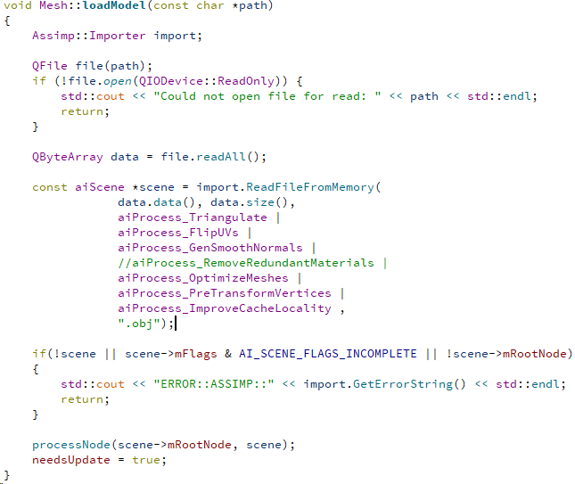
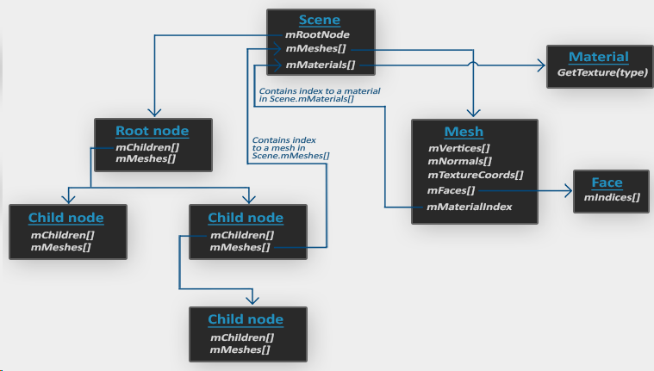
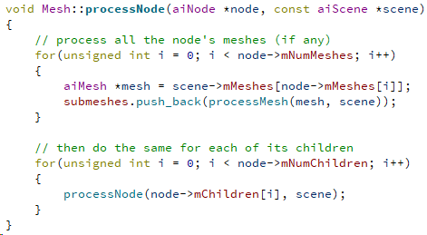
Loading models with Assimp

Slide 20
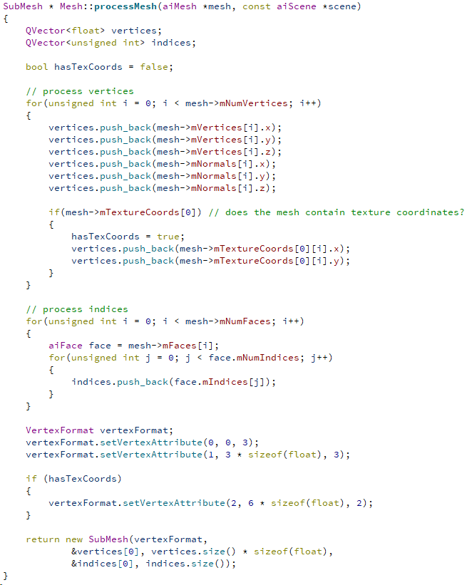
Loading models with Assimp

Slide 21
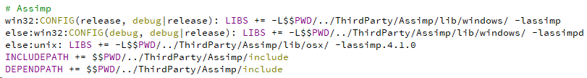
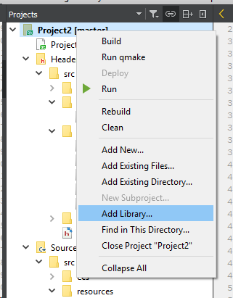
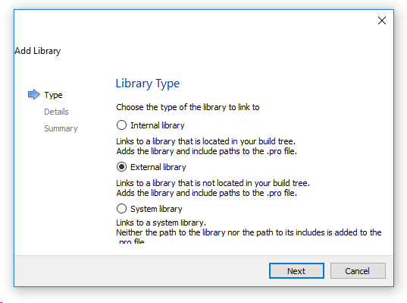
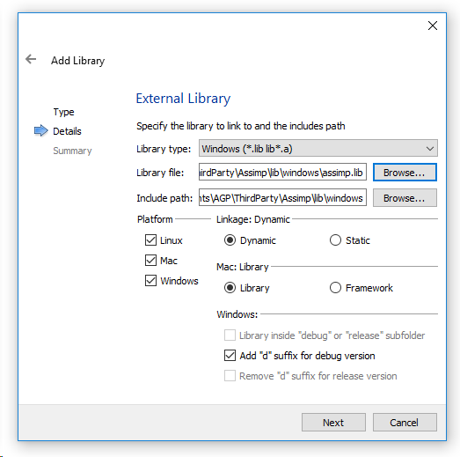
Adding Assimp to the project
Project file (.pro)
Find the headers and binaries of Assimp in the virtual campus:
Compiled for Release and Debug modes

